Slide 1
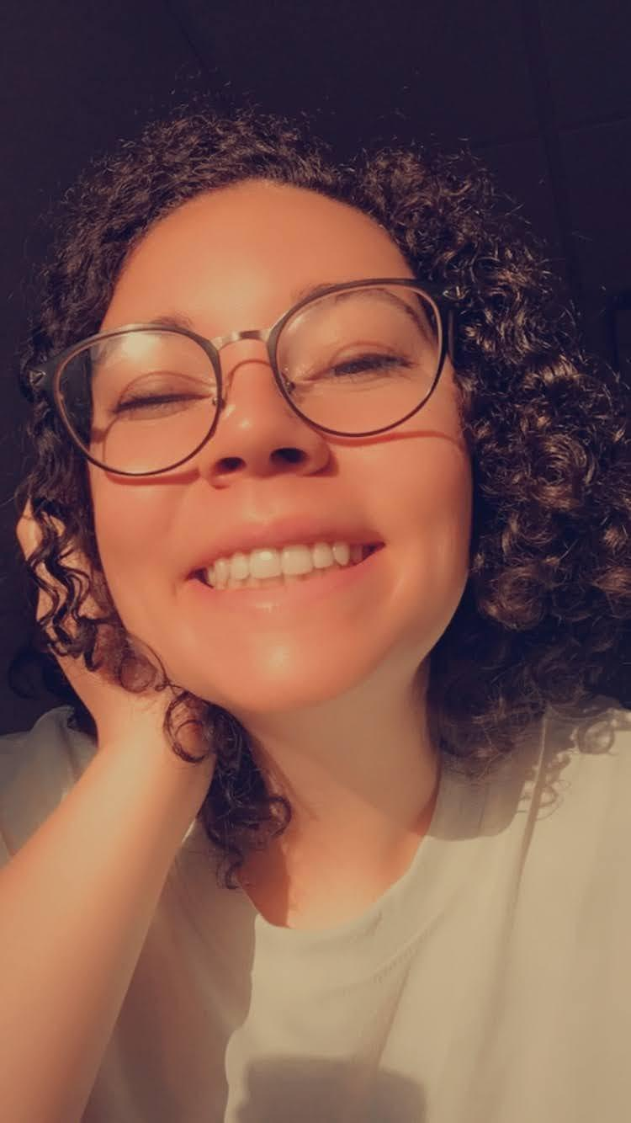
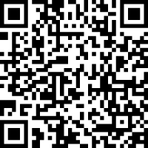
RESEARCH As a Freshman
Poster made by: Emily Gonçalves
How I got to do Research?
Me!
What Does Applying Look Like?
Why Should You do research?
I went to this very same event where I met serenbetz grant students who did their research. I talked to a student who did her project on the vaginal microbiome. the microbiome is something that intrigues me and I wanted to learn more about it. I walked around and had talked to enough people that they started talking to other people about me! Eventually Dr. Ross and I found each other. She said I have to talk to you and I said I have to talk to you. She talked to me about how my enthusiasm shined and she would give me a helping hand to start research.
It was only a few weeks later when I had found my faculty sponsor and we were starting on the paperwork for gaining credit.
Funding decisions will be made by the Leadership Team, a committee composed of students, faculty, and administrative staff. Faculty and student members of the Leadership Team are appointed by the Vice President of Academic Affairs Applications will be prioritized by merit and the quality of their application.
A rubric will guide evaluation that addresses overall depth, forethought, quality and strength of individual application sections. Students are strongly encouraged to work with their advisor and/or the Writing Center to ensure that a high-quality application is submitted
This opportunity allows students on campus to flourish into experts of their field. These opportunities help create a strong future for women in research fields!
Students from all sorts of disciplines are able to apply for research money. There are students who research in STEM fields but also leadership, WGS, business. All these opportunities help Cottey Students start their professional career.
Research also gives many undergraduates the confidence they need when they leave the safe haven of Cottey. This research opportunity has impacted the lives of so many students already! The support from the Cottey faculty also creates a great working environment for students to know what respect and professionalism looks like.
What have I learned?
My faculty sponsor was also a first year at Cottey. He was just as interested and excited to start as I was.
Dr. Librande had me learn the basics first: how to collect research, how to stain and grow bacteria. All of these fundamentals laid a solid foundation for real work to get done. Because I was the only one asking to do research with him I was incharge of everything I learned or wanted to dive into.
With that in mind we had come up with a research question and how to answer it within the suggested budget. This was when we officially started applying for funding from the Serenbetz institute
What I Would Have Done
Because of the spring semester ending early I was unable to do research. I would have started after spring break. Dr. Librande and I had all our volunteers for skin swabs. All of the students were apart of a biology class that had micro bacteria in it. Our question was would these micro bacteria from class impact their own microbiome.
With every research opportunity students also have to go to a confrence and my conference was suppose to be in Boston; The Digestive Disease week Conference
Who Else Can Apply?
Any Baccalaureate students with at least a 3.0 cumulative GPA as well as faculty sponsors are eligible to apply for grants up to $2,000.
Students do not have to do research that falls under their declared major. In fact if there are many Psychology majors who go to theater conferences to better understand how to empathize
QR Code to an Audio Version of My Story

Slide 2
Script for audio file
Hello, This is Emily Goncalves and I’m going to talk about my research experience as a freshman last year. During this time last year I was also invited to the Serenbetz Open House. It was the stories and experiences of other research students that encouraged me to start the process of applying.
I was inspired by a student who also did their research on the microbiome. I wanted to do something similar, so I asked the only teacher I knew, Dr. Librande to be my faculty sponsor. He was also a first year to cottey; so he was excited to start doing research too. We came up with a question and how we would answer it.
Our question was: Does Attending Class Make You Unhealthy? Effects on Participation in a microbiology lab on the skin microbiome. I had to learn basic techniques: collection methods, staing, data collection, research methods, and all that sort of thing before we could even start applying for money.
The application was long and detailed but it got us funds to finally start the project! the plan was to start after spring break. things didn’t really go to plan after that but i am still proud of my experience and am so glad I could share it with you!
Research is for everyone! if you want to study under someone, apply! what you study does not even have to be related to your 4 year degree, as long as you are dedicated and want to apply you can!

