Slide 1
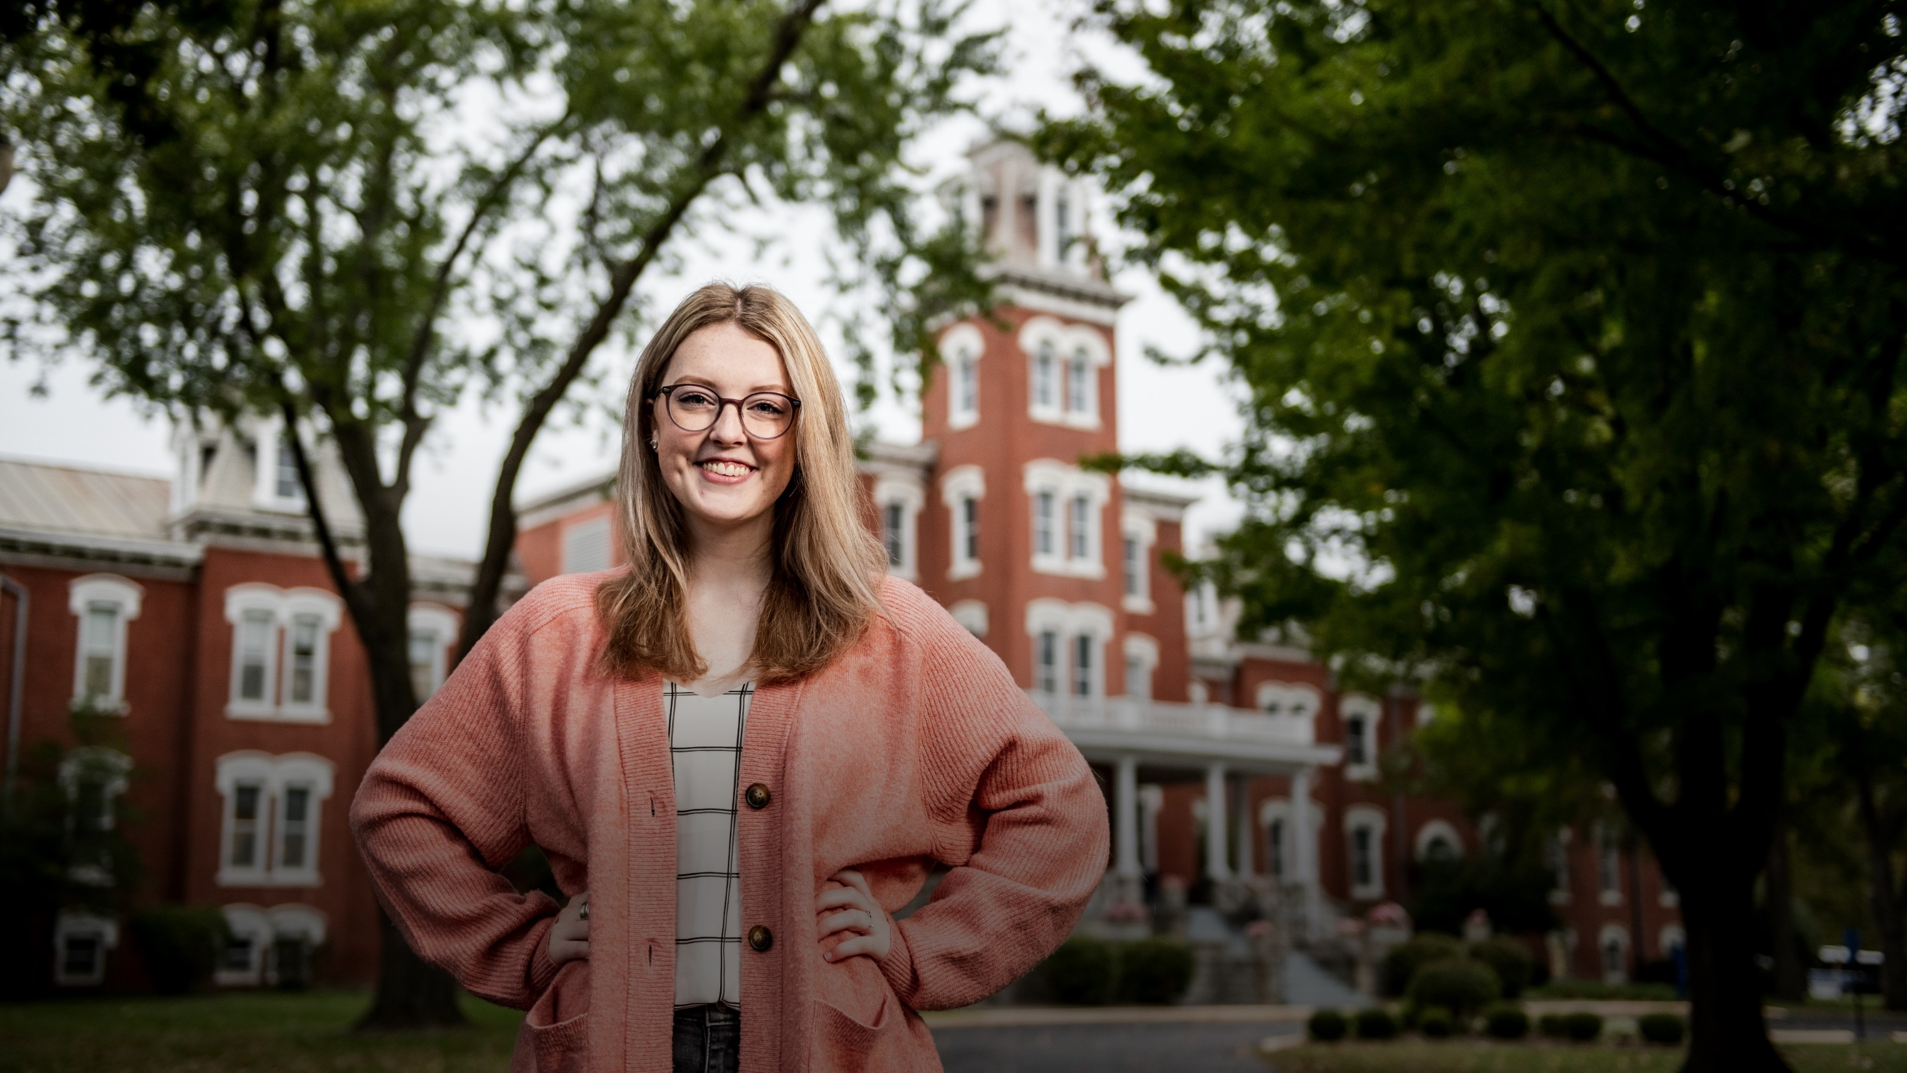
P.E.O. CHAPTER PRESENTATION
Cottey College

Slide 2
OF COTTEY
Founding Story

Slide 3
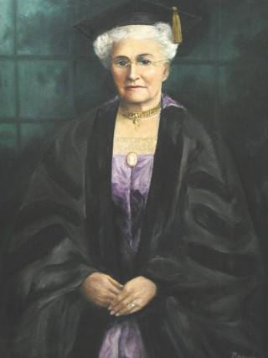
FOUNDED
By Virginia Alice Cottey in 1884
Women deserve the same quality of education as men
EQUALITY IN EDUCATION
STARTING HER COLLEGE
Virginia Alice took her savings of $3,000 and contacted Methodist ministers around Missouri. Finally a reverend in Nevada, MO agreed to donate the land for the school to be built.
Virginia
Alice
Cottey
A SPECIAL GIFT
In 1927, she gifted the school to the P.E.O. Sisterhood to take care of the college moving forward.
Notes:
Virginia Alice grew up in a time and place where educational opportunities for young women were limited, but she did not let that stop her from pursuing her passion for learning and teaching.
Despite limited resources and support, Virginia Alice became a voracious reader and developed a deep commitment to the idea that women should have the same access to education as men.
Her determination to start a college was inspired by Mary Lyon, founder of Mount Holyoke College.
With $3,000 in savings and a strong determination to start a college for women, Virginia contacted Methodist ministers all over Missouri looking for partners. $3,000 in 1884 would be worth over $90,000 in 2023.
Reverend McClure and Mr. Harry C. Moore of Nevada, MO responded to the proposal and saw a college as an opportunity for their town.
The partnership resulted in the founding of what is now Cottey College.
Virginia Alice’s legacy lives on at Cottey College, where she founded the school and built the original schoolhouse that still stands at the center of Main Hall.
In 1927, she gifted the school to the P.E.O. Sisterhood, seeing it as the appropriate shepherd to take the college forward.

Slide 4
Today’s Cottey

Slide 5
Enrollment: 266 students (fall 2023)
Student body: 37 states represented and 9 countries (fall 2023)
Alumnae: 10,600+
Campus: 15 buildings on 12 city blocks
Student/Faculty Ratio: 7:1
Athletics: 8 scholarship sports offered (3 sports coming in 2024 – Cheer, Dance, Bowling)
Ranked as a Top 10 Best Midwest Regional College by U.S. News and World Report 7 consecutive years.
Notes:
Today Cottey is a nationally ranked independent, liberal arts and sciences college for women.
Students come from across the country and from around the world to Nevada to attend Cottey.
With a student/faculty ratio of 7:1 students receive truly personalized instruction and education.
Cottey College has a strong athletic program that includes volleyball, basketball, cross country, track and field, flag football, esports, golf, and softball. In 2024 Cottey will add competitive Cheerleading, Dance, and Bowling.
The athletic teams at Cottey are members of the National Association of Intercollegiate Athletics (NAIA) and the American Midwest Conference (AMC).
Cottey College was ranked for the 7th consecutive year as a Top 10 Best Regional Colleges in Midwest by U.S. News & World Report.

Slide 6
OF ATTENDING COTTEY
Cost

Slide 7
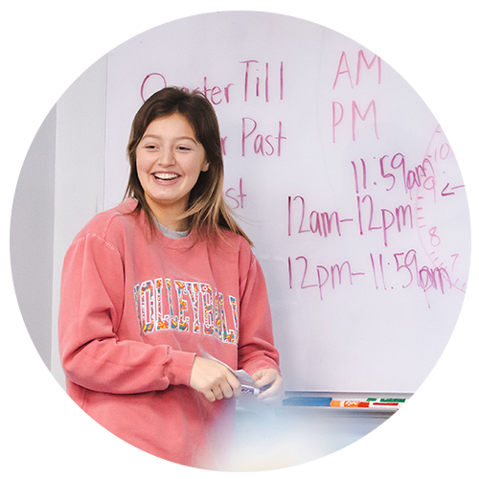
98%
46%
Of students received financial aid
Of students who graduated in 2022 had no debt
Notes:
Cottey College is committed to making education affordable and accessible to all students.
The College offers generous financial aid packages to students, including need-based scholarships and merit-based scholarships.
Cottey's tuition and fees are significantly lower than the national average for private colleges and universities.
Cottey offers a variety of payment plans to help students and families manage the cost of attendance.
The College also has a student employment program, which provides opportunities for students to earn money to help pay for their education.
Cottey is committed to helping students graduate with as little debt as possible, and the College has a low average student loan debt compared to other private colleges and universities.

Slide 8
BACCALAUREATE AND ASSOCIATE
Degree Programs

Slide 9
4-YEAR BACCALAUREATE DEGREE PROGRAMS
Biology
Business Administration/Management
Criminology
Elementary Education
English
Environmental Studies
Health and Biomedical Sciences
History
International Business
International Relations
Organizational Leadership
Political Science
Psychology
Secondary Education
Theatre
Women, Gender and Sexuality Studies
2-YEAR ASSOCIATE DEGREE PROGRAMS
Associate of Arts
Associate of Science
Notes:
Cottey's academic offerings are designed to emphasize high academic standards with unique opportunities for personal growth through residential, cultural, and intellectual experiences.
The faculty at Cottey College is made up of experienced educators who are passionate about teaching and mentoring young women to become leaders in their respective fields. In 2021, the Chronicle of Higher Education listed Cottey as the #1 private college in the U.S. for student to tenured faculty ratio. Meaning there were more faculty with the highest degree in their field per student at Cottey than any other college or university.
The college is accredited by the Higher Learning Commission (HLC) and has received recognition from various organizations for its academic excellence and commitment to student success.

Slide 10
KEY DIFFERENTIATOR
International Experience

Slide 11
OVERVIEW
One week experience internationally
Program began in 2000
Cottey pays for airfare, hotel, and some meals
Some past destinations include: London, Paris, Florence, and Madrid
A Cottey student respects diversity, is attentive to cultural context, and demonstrates ethical reasoning and action.
Students learn about the history, politics, economy and geography of the country. Through journaling, students assess the similarities and differences in the beliefs, behaviors and customs of the international location and the United States.
STEP INTO THE WORLD CLASS
Notes:
Cottey College believes in providing a global education to every student.
Third-year students (more than 56 credits) and transfer students (Completed at least two semesters at Cottey College as a full-time student by the end of the fall semester prior to the international experience) have the opportunity to visit a European city with classmates and faculty during the first week of spring break.
The experience is an opportunity to learn about art, history, science, and culture.
There is no extra tuition fee for this experience.
Cottey College covers the cost of airfare and hotel for students.
Prior to departure, each student takes a class called “Step into the World” where they learn a variety of things about the destination including history, politics, and economics.
While in the country students participate in two elective “modules” to learn more about more focused topics such as art, architecture, cuisine, etc.

Slide 12
CAMPUS EXPERIENCE
Student Life

Slide 13
More than 25 clubs and student organizations
INCLUDING:
ART CLUB
BAKING CLUB
BOARD GAME CLUB
STUDENTS AGAINST A VANISHING ENVIRONMENT
Notes:
Cottey College offers more than 25 student organizations on campus.
These organizations represent a diverse range of interests, including academic areas, cultural and recreational interests, social, religious, and volunteer activities.
Students can also create their own organization if they don't find one that fits their interests.
Student organizations give students opportunities to exercise leadership and organization skills in a practical setting.

Slide 14
8-14 STUDENTS IN A SUITE
LIVING AREA
KITCHEN
MULTI-UNIT BATHROOM
BEDROOMS (SINGLE AND DOUBLE)
SHARED LIVING SPACES ARE CLEANED BY COTTEY STAFF
Suite Life
Notes:
Cottey College has three residence halls that each house 100-150 students.
The suites are apartment-style with a living room, large bathroom, and kitchenette.
Suites accommodate 8-14 students and include single and double bedroom layouts.
The suite life allows for greater independence and privacy compared to traditional dorms.
Living in a suite encourages socializing and building a strong sense of community among residents.
Suites are furnished and have heat and air conditioning.
Residents have access to laundry facilities, computer labs, and a lounge area in each residence hall.
Residence halls have resident assistants who offer support and help to build a welcoming environment for everyone.

Slide 15
Campus Life
CAMPUS ACTIVITIES
EVENTS
PROGRAMS
Notes:
Each week a variety of activities take place on campus to help inform, engage, and entertain students.
Campus events and activities include cultural and social events, concerts, plays, guest lectures, and athletic events.
Cottey has many fun and long-standing traditions that are also part of campus life. Singing, ducks, daisy’s, signing of the Cottey book, special events, and more all are part of the student experience at Cottey.
The College also provides road trips for students to Kansas City, St. Louis, and other regional locations in order to give the students a chance to get off campus.

Slide 16
PREPARATION
Career

Slide 17
CAREER PREPARATION
LEADERSHIP AND GLOBAL AWARENESS
The Serenbetz Institute for Women’s Leadership, Social Responsibility, and Global Awareness was established in the fall of 2010 to support Cottey College’s mission to educate women so they may realize their full potential as “learners, leaders, and citizens.”
The Serenbetz Institute issues grant awards to Cottey College students and faculty to enhance learning through summer leadership internships, undergraduate research grants, leadership immersions, and other leadership programming.
Notes:
Cottey has a strong tradition of women's leadership, with many alumnae going on to become successful professionals, entrepreneurs, and community leaders.
The college encourages women to speak up and advocate for themselves and others, providing opportunities for public speaking, debate, and other forms of communication.
Cottey's curriculum and programs focus on promoting women's empowerment and social justice, helping women to find their voices as agents of change in their communities and beyond.
The Serenbetz Institute for Women’s Leadership, Social Responsibility, and Global Awareness was established in the fall of 2010 to support Cottey College’s mission to educate women so they may realize their full potential as “learners, leaders, and citizens.” It issues grant awards to students and faculty to enhance learning and provide leadership programming.

Slide 18
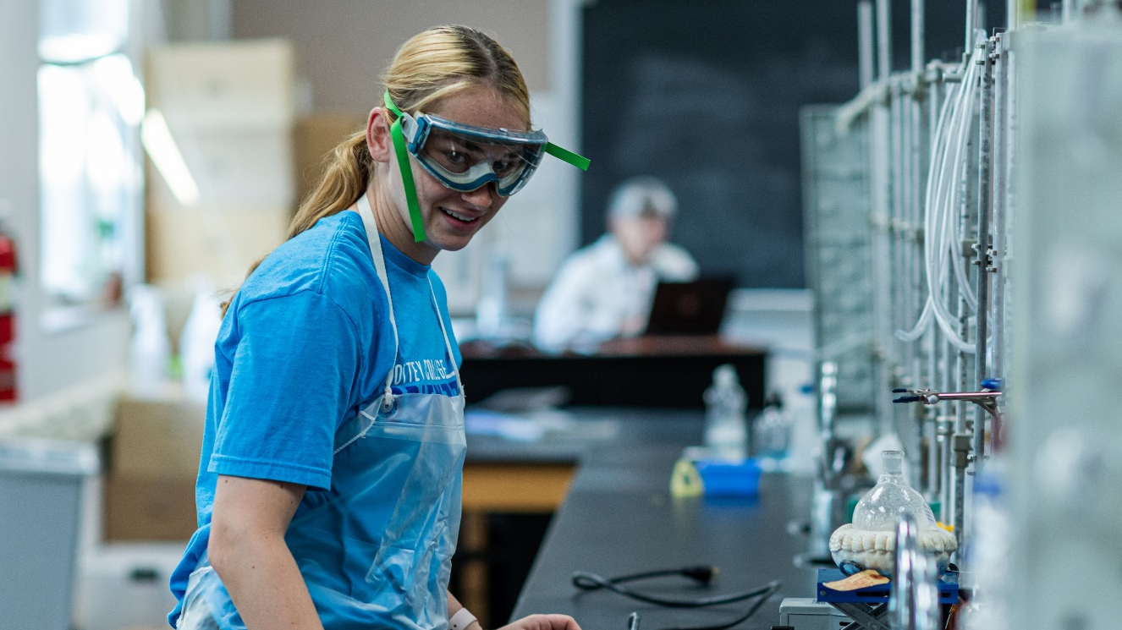
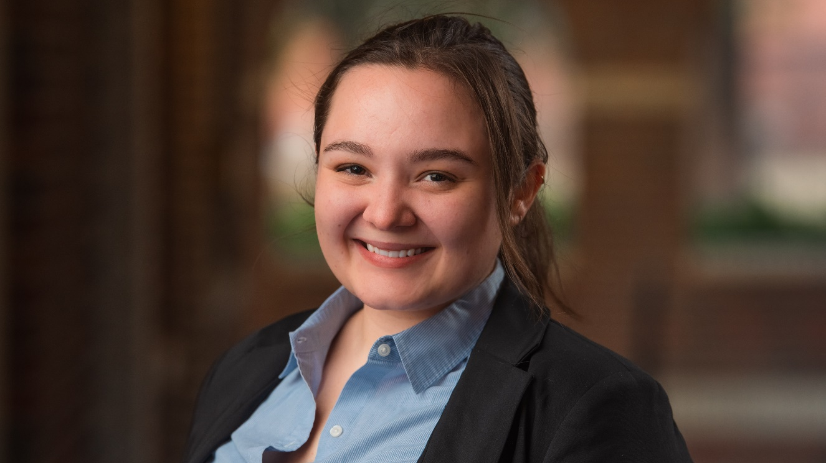
INTERNSHIPS
CAREER PREPARATION
CAREER SERVICES
Approximately 25% of students complete an internship each year.
Mock Interview Process and Job Search Assistance
Notes:
Internships are a great way for Cottey students to gain experience in a field of interest and build their professional network.
Cottey’s Career Services Center has developed an annual workshop that includes a mock interview process for students.
Career Services personnel arrange a panel of industry-specific professionals for each student’s mock interview.
After the interview, each panel member writes a review of the students’ interviews, giving detailed feedback.

Slide 19
HOW CAN P.E.O. MEMBERS HELP?
Supporting Cottey

Slide 20
Referrals
Visiting Cottey
Do you or someone in your sphere of influence have a student in high school?
Talk about Cottey
P.E.O. Visit Day
Vacation College
Individual Tours
Supporting Students
“Support a Suite” and “Support a Student” programs
Cottey Cash
Finals Week Care Packages
Cakes for Cottey
COTTEY.EDU/PEO
Notes:
Referrals
"Education is the passport to the future, for tomorrow belongs to those who prepare for it today." - Malala Yousafzai
Do you or someone in your sphere of influence have a student in high school?
Talk about Cottey with your friends, family, and colleagues who have daughters, granddaughters, or nieces who are looking for a college that will empower them to succeed. Your recommendation could make a big difference in their life!
Supporting Students
The support-a-student/suite program is coordinated by the individual state/district/provincial (S/P/D) Cottey committees. All questions regarding these programs should be addressed to the state Cottey chairmen or advisors.
Cottey Cash is an internal gift certificate that students can use in Chellie Club, Raney Dining Room, for shuttle reservations, event tickets, or the Spirit Shop. Orders may be made online.
A Finals Week Care Package is an opportunity to show support for a student or suite members with all proceeds supporting the Nancy Denman Student Life Scholarship. For a $25 purchase, care packages are assembled in a reusable Cottey tote bag loaded with snacks! Two pieces of fruit, nuts, candy, breakfast bars, a full-size candy bar, cheese and crackers, gum, chips, and of course, chocolate, along with other goodies to keep a student fueled for studying!
For $20, P.E.O. members can choose either a frosted 9×13 rectangular cake or an angel food cake to be delivered to a student’s residence hall on or near her birthday or other special occasion. Members of P.E.O. Chapter DW in Nevada, Missouri, will bake a cake and deliver it to the student.
Visiting Cottey
You’re always invited to come and gain a deeper understanding and appreciation for the history, mission, and values of Cottey College.
See firsthand the impact of P.E.O. International's support and contributions to the education and empowerment of young women.
Connect with current students, faculty, and staff and learn about their experiences and perspectives.
P.E.O. Visit Day is a one day event generally on a Saturday in October. Last year over 50 P.E.O. members came to campus to interact with students and learn about Cottey.
Vacation College is a unique program that allows adults to experience college life at Cottey College for one week during the summer.
The program offers a variety of classes and workshops taught by Cottey faculty, ranging from art and literature to science and technology.
Private Tours are available and can be booked online or by calling Cottey.
Resources, Information, and More is available on the Cottey website. www.Cottey.edu/PEO

Slide 21
Thank
You!

